Slide 1
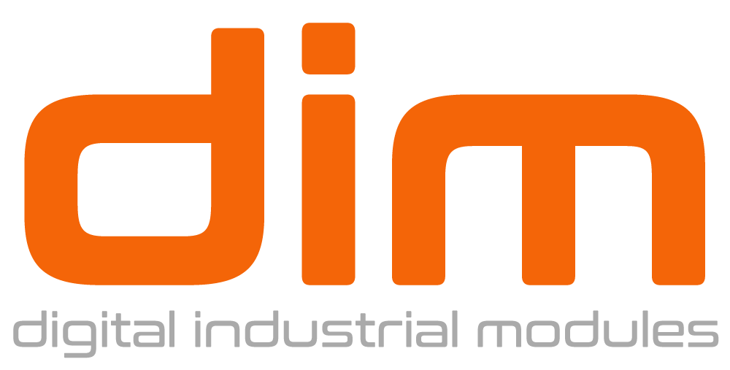

Slide 2
What is DIM?
An ML powered construction platform that collects on-site daily activities,
analyses actual costs and forecasts financial variances based on trends, in real time.
Notes:
Change the sentence

Slide 3
CONSTRUCTION SITE BUDGETS SKYROCKET
Projects typically take 20 % longer to finish than scheduled
and are up to 80 % over budget.
https://www.mckinsey.com/business-functions/operations/our-insights/imagining-constructions-digital-future

Slide 4
MAJOR UNANSWERED QUESTION
What is the financial impact of Activities Performed (FIAP) today?
No detection of deviations as it happens
Analytics contain hidden non-traceable deficiencies
Reports do not reflect the exact and real site status
No Proactive, Preventive measures

Slide 5
HOW FIAP IS CALCULATED
In a simplified matter
$
Increase 80%
Compare
Analyze & Issue
Collect activities
performed on site
To initially budgeted costs
Timely reports
and analytics

Slide 6
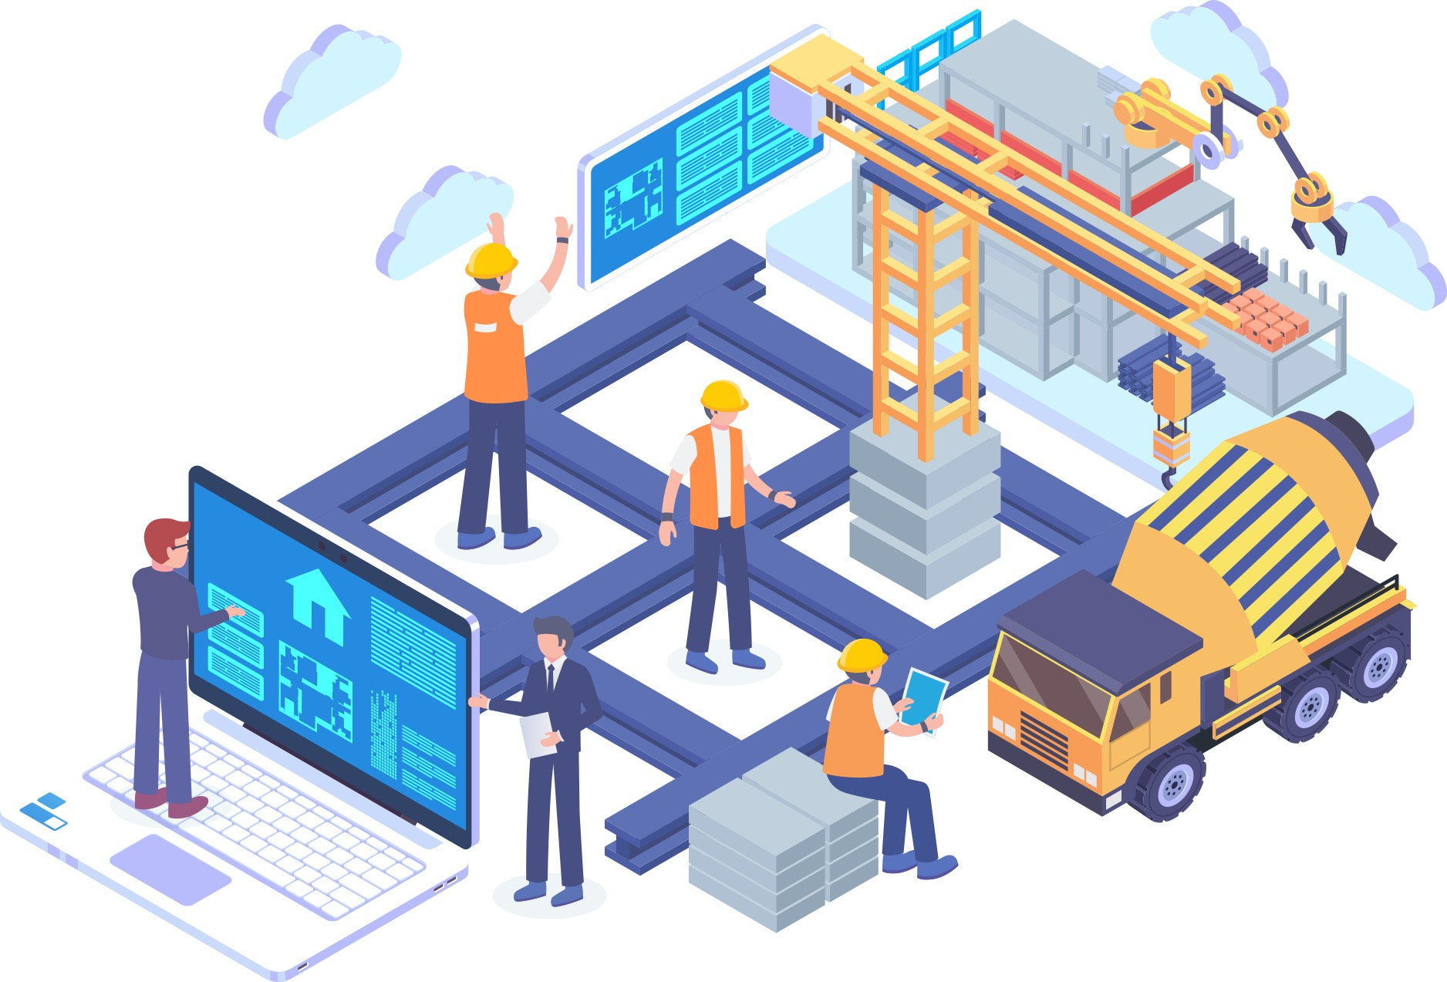
WHY FIAP CAN’T BE CALCULATED TODAY?
Data is Corrupted
Not all activities are collected: usually major activities are partially outlined in the daily report. Details related to each activity such as quantities, locations, hours spent on each activity, tools and equipment used are not consistently recorded.
1
Unreliable Comparisons
The comparisons between what was executed and what was planned is done manually.
Even if collected digitally, daily reports are sent via email. Human intervention is prone to error and delays.
2
Too Many Manual Steps
Due to the fact that data is being collected in different formats (e.g. paper, email, excel sheets, word documents, etc.…) compiling and converting it into actionable data to enable relevant comparison with similar formats takes time and is prone to human error.
3

Slide 7
THE SOLUTION
DIM is the solution
Digital collection of all activities on a daily basis
Real time comparison. Eliminate all manual steps
Instant reports. Accurate, and reliable analytics.

Slide 8
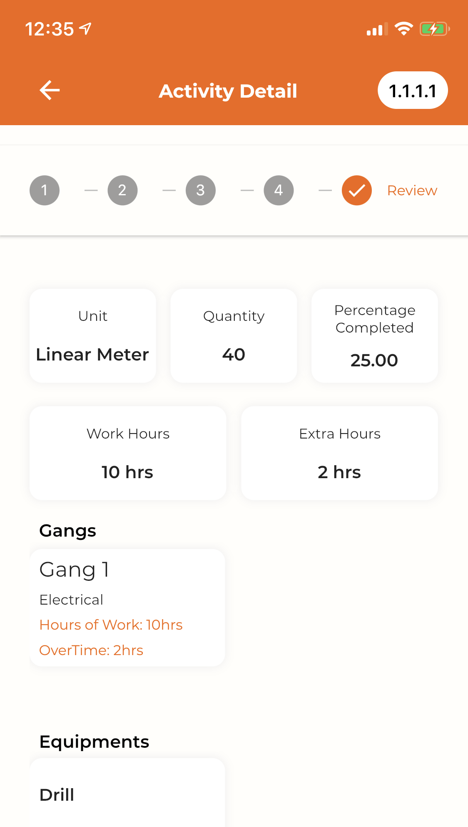
THE PRODUCT
DIM Platform uses Mobile & Web Technologies
Live
Submission
+
Analysis
Daily input of every activity performed on site
Instant accurate reporting

Slide 9
THE PRODUCT
Benefits
Detect deviations as they happen
Allow proactive and predictive actions
Save cost and time
Monitor daily performance on site
Allow traceability and accountability
Grow Sustainably
Predict and assess potential scenarios
Win bids with competitive prices
Replicate best practices to other projects

Slide 10
COMPETITION
Collaborative
Financial forecasting
ML powered insights
Notes:
Construction problems are huge, all of these solutions including ourselves focus on saving time for construction clients. However, I don’t view them as competitors more like complimentary solutions, they focus on the site collaboration stage. Where we come in is focusing on financial implications and projections of what happens on site. No one is currently focusing on this.
New slide:
For example, lets say you are on site, you already poured the beam and now you want to install the duct, you find that if you will execute the duct as per the drawings it will hit the beam. Instead of the traditional process where you would now need to go back and forth with people off-site asynchronously and using different tools, these other solutions centralize and facilitate that collaboration.
Our solution
I am focusing on using we cannot solve all the problems in one solution, rather what we can do is like complement each other

Slide 11
THE MARKET
Construction Worldwide 13% GDP
ConTech: 1% of budget typically allocated to technology
$120+ Billion
$70+ Billion
Target Market
Reach 1.5%
Europe, GCC, England, USA
Of $70 Billion
target market
$1+ Billion
Notes:
Changed the figures and texte

Slide 12
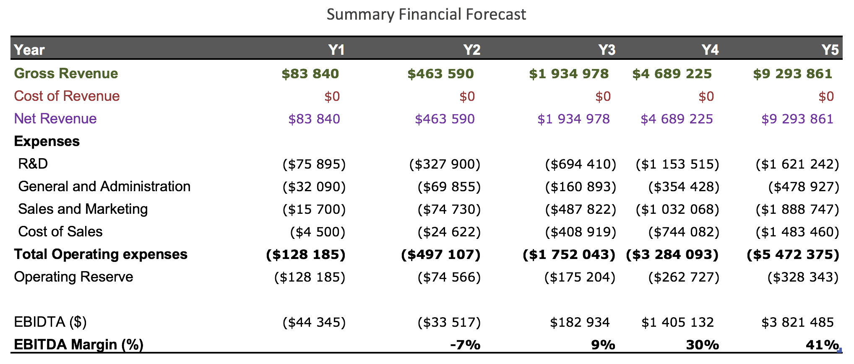
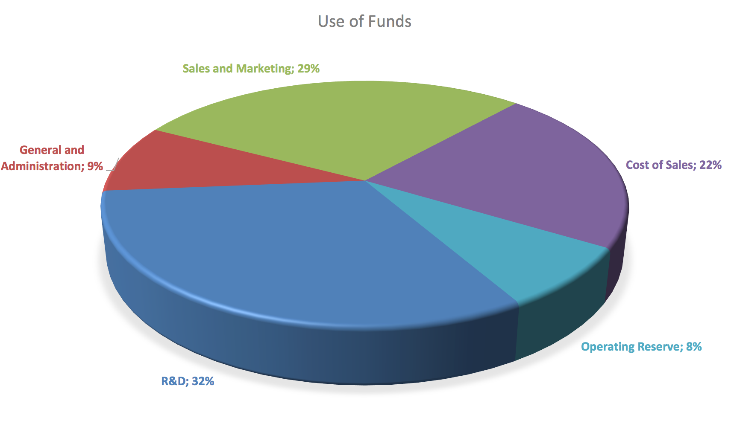
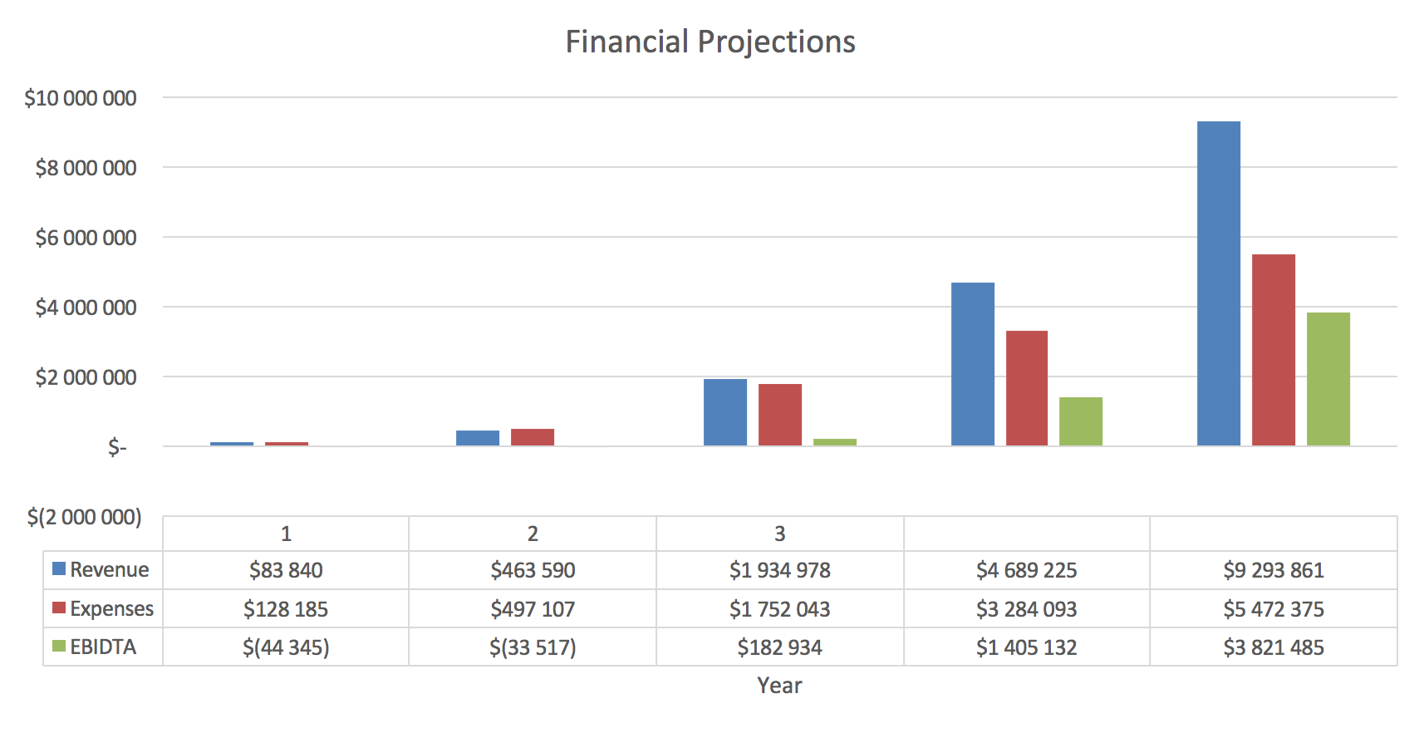
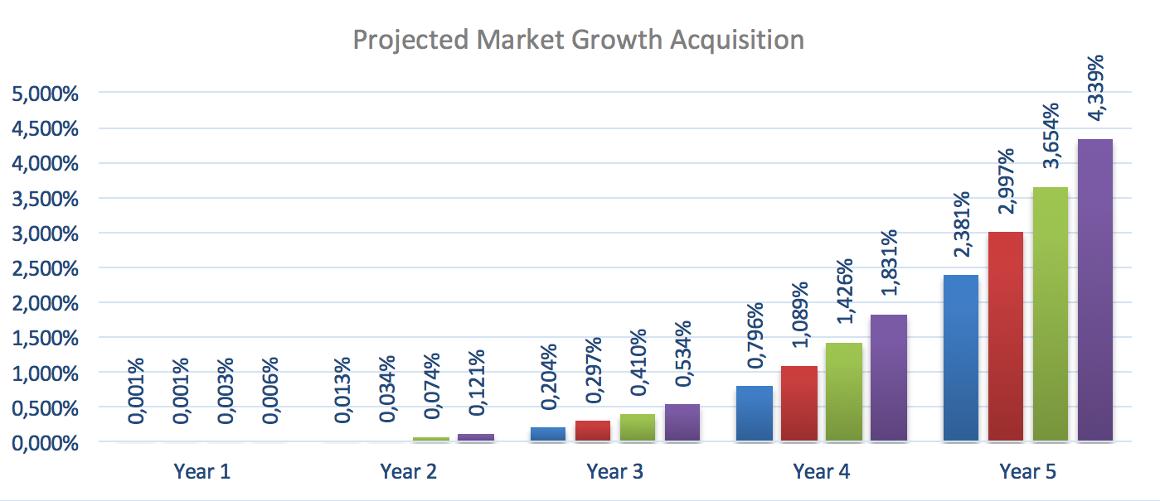
FINANCIAL PROJECTIONS

Slide 13
TRACTION
Pilot Project
March 2020
2 Clients – 7 Projects
May 2021
Advanced Neg. Bouygues
Target to sign in June 2021
70+ Potential Clients
Europe - MENA/Golf
Africa
Europe - Africa

Slide 14
THE TEAM
Michella abou jaOUde
SOUHAIL JABBOUR
Co-founder: Chief Executive Office
Co-founder: Chief Technology Officer
Architect + MBA
16 years project management experience in Construction
Worked with local and international contractor and developers in Lebanon, Riyadh, Qatar
Computer Science BS + MBA
18 years experience in SaaS software development, including building ERP system for an international contracting company
Prior founder and CTO experience
+ 3 developers

Slide 15
BUSINESS MODEL
SaaS Model
/CLIENT/PROJECT
ENTERPRISE
API & CONNECTORS
€
350
CUSTOM
PRICING
CUSTOM
PRICING
/ month
Unlimited Users
Unlimited Projects
Unlimited Users
Custom API Creation
Custom Data Connectors
Dedicated Support
Adoption Fee: € 10,000

Slide 16
DIM literally saves time and money
THANK YOU
WEBSITE
https://www.dim.construction
EMAIL
michella@dim.construction
PHONE
+961 3 455 576
+33 6 76 75 12 50

