Slide 1
hipli
Reusable packaging for e-commerce

Slide 2
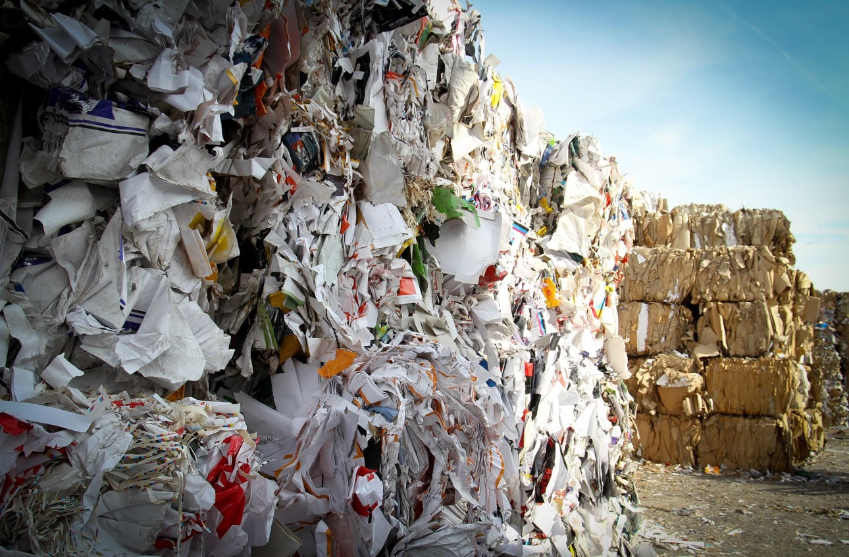
90 billion parcels sent every year

Slide 3
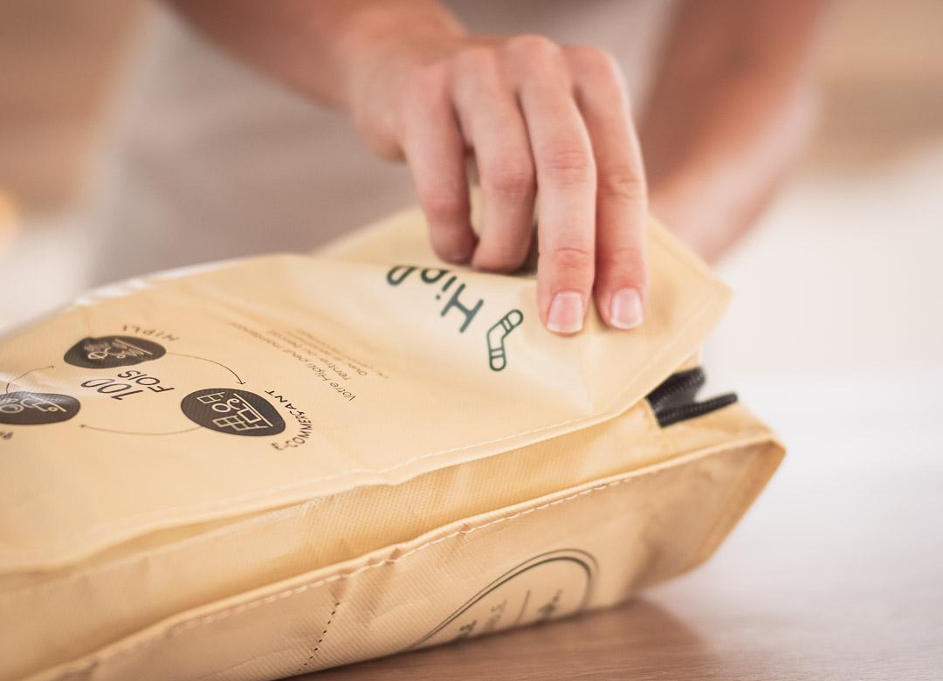
A reusable
packaging
A logistics to ensure it really is reused

Slide 4
The end of trash
A new customer experience

Slide 5
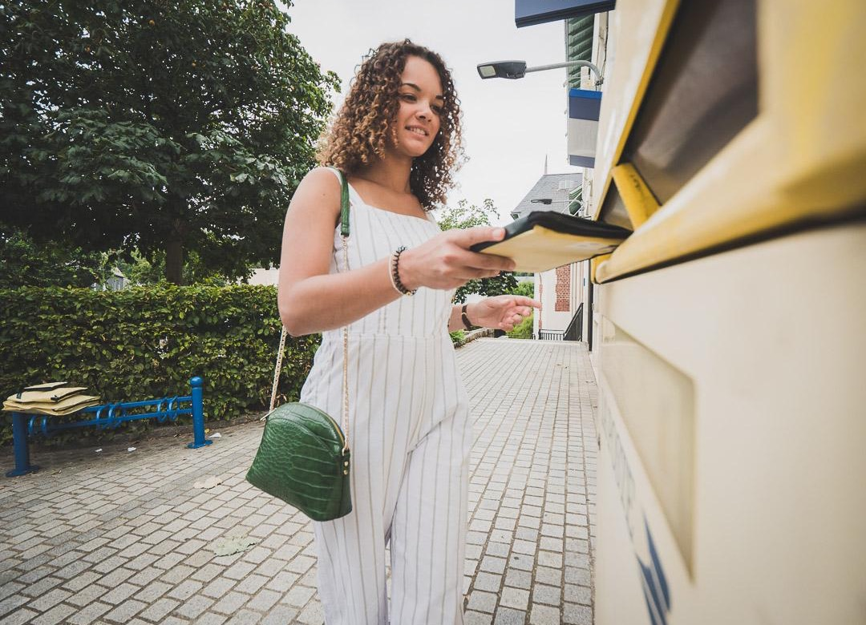
Free
return
for your
clients

Slide 6
It is easy
You clients return the parcel for free
Prepaid return stamping is printed on the parcel with no validity limit
Can be put in any street mailbox
We are conditioning all the parcels
We inspect, clean and disinfect the parcels
You make a new order as soon as you are out of parcels
Send your orders in a reusable parcel
Compatible with all carriers and networks
You can directly stick the sending label
Reduce the packing time

Slide 7
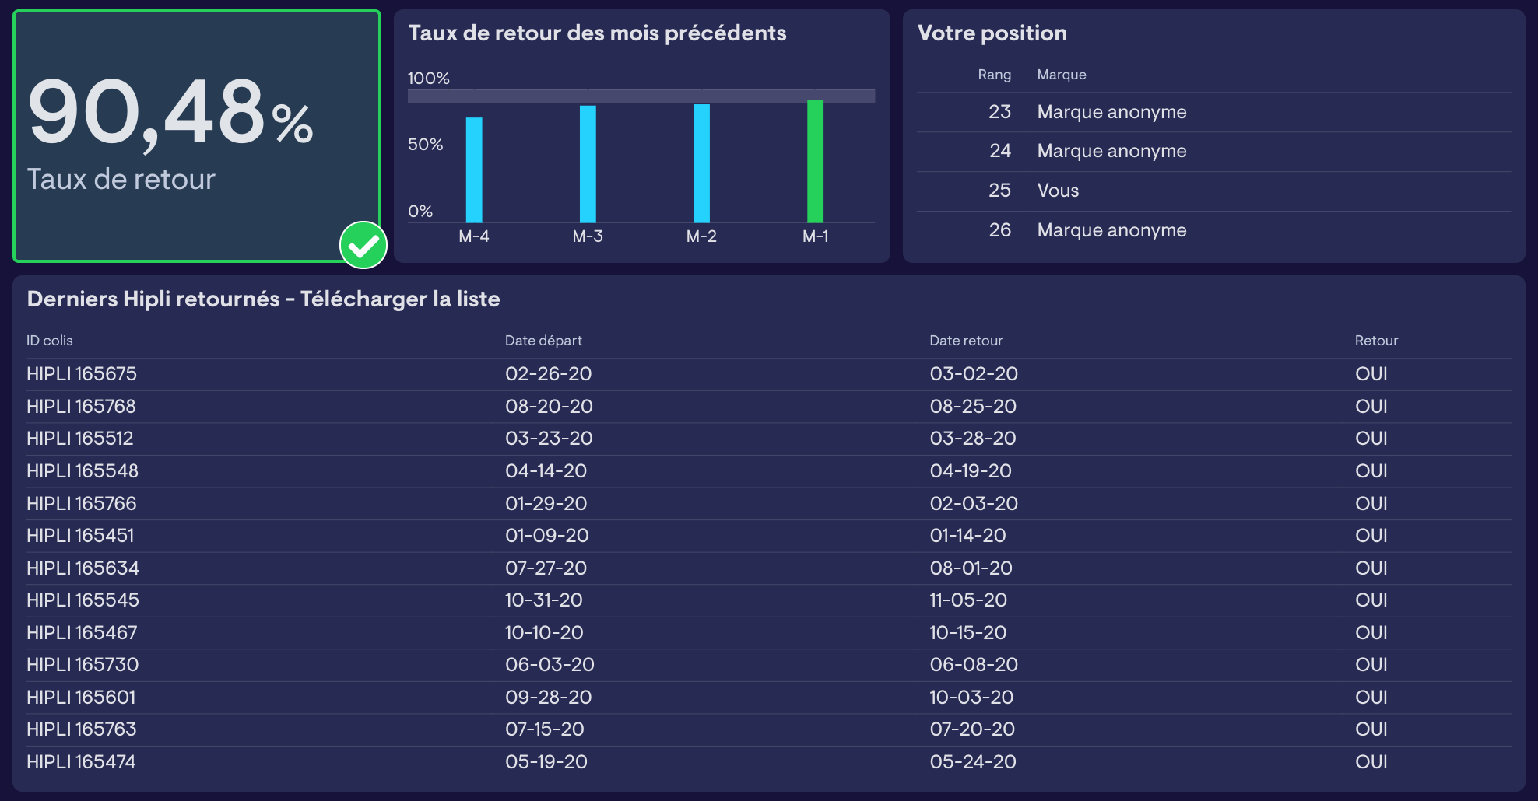
Transparent tracking of parcels
All the parcels are equipped with a barcode :
Individual tracking of each parcel
Enables associating the parcel to the client during the dispatch
Calculate the return rate for each brand

Slide 8
A high take up rate
Delivery in a reusable parcel is always an option, a choice for your clients to play along
88%
55%
of clients are choosing the option when it’s free
of clients are choosing the option chan it is offered for 1€

Slide 9
A real impact
Return rate of 89%
-77%
-25 kg
carbon impact
garbage per parcel
Source : EVEA Impact Study 2020
https://hipli.fr/impact-environnemental/

Slide 10
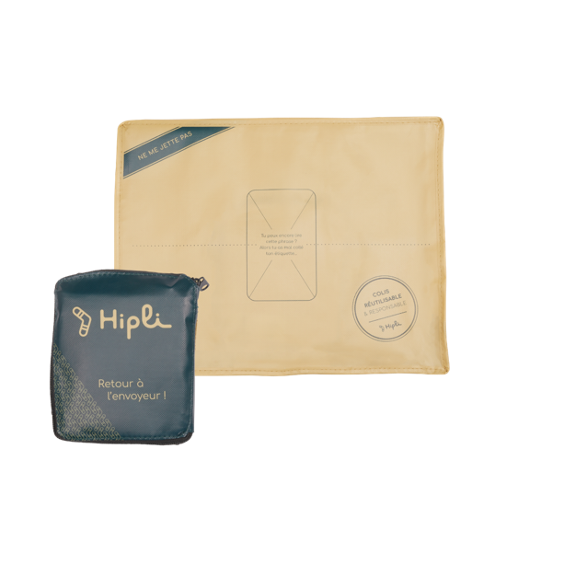
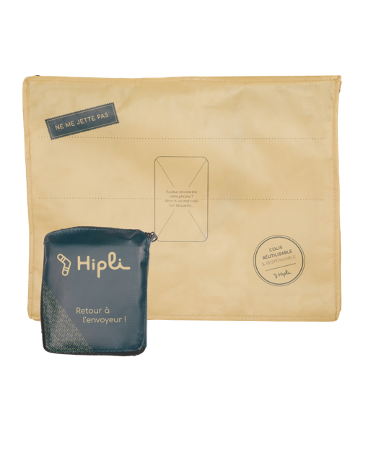
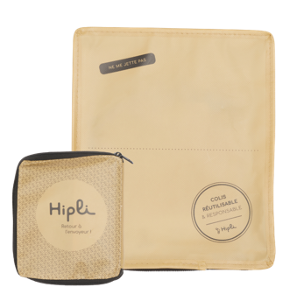
A price at use
Minus
21x25x4cm
Postal return included
1,80€
Hiplus
30x38x7cm
Postal return included
2€
Magnus
37x47x12cm
Postal return included
2,3€
Delivery in 5 days, no commitment, no subscription

Slide 11
In ten months, Hipli is :
130+
100 000
brands and marketpkaces
parcels

Slide 12
Let’s go further together
@hiplicolis
@hipli
Léa GOT
Co-founder / Sales & Marketing
l.got@hipli.fr
Anne-Sophie RAOULT
Co-founder / Opérations
As.raoult@hipli.fr
www.hipli.fr
+33 (0)6 14 76 67 09
+33 (0)6 13 62 92 84

